Slide 1

Team Details
Team name: Sakhii
Problem Statement: Build an AI-powered chatbot for women empowerment with job listings, mentorship programs, and event tracking.

Slide 2
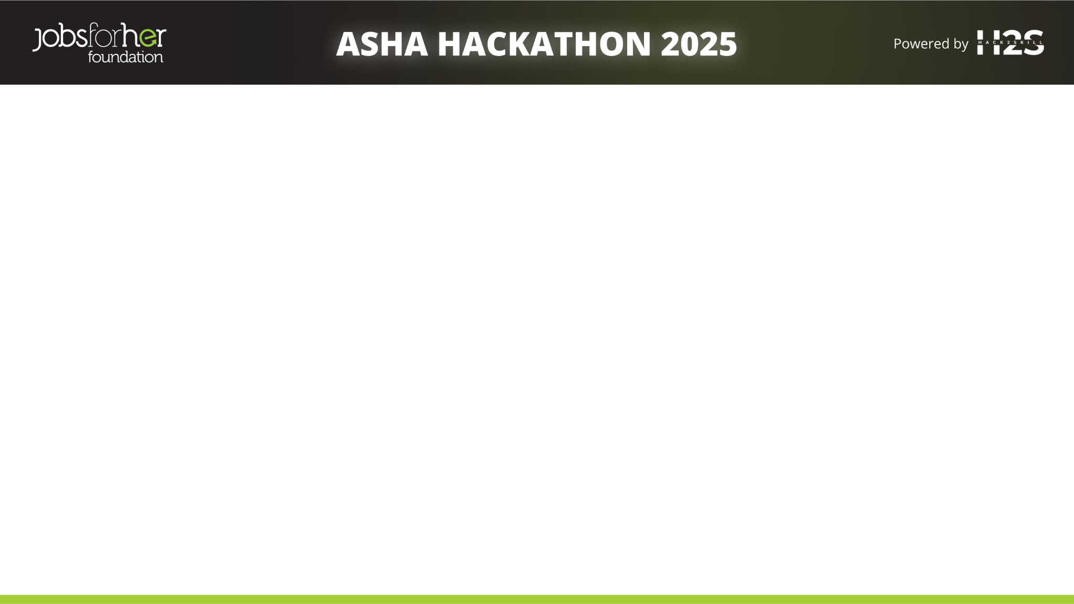
Brief about the idea
Asha AI Bot is a women empowerment-focused chatbot that provides:
Job opportunities
Events information
Mentorship programs
Gender bias detection in conversations
It uses context-aware multi-turn conversation handling, RAG (Retrieval-Augmented Generation), and bias detection techniques to ensure ethical, inclusive, and useful responses.

Slide 3
Opportunities
How different is it from any of the other existing ideas?
Women-Focused Knowledge Base: Unlike generic chatbots, Asha AI Bot focuses specifically on women-centric jobs, mentorships, and events.
Built-in Gender Bias Detection: Most bots don't actively detect or correct gender-biased language — Asha Bot proactively neutralizes bias in real-time.
Ethical AI by Design: Privacy-respecting, inclusive responses and adherence to global AI ethics frameworks — rare among basic AI bots.
Real-Time Context Updates (RAG System) : Pulls latest, verified job and event info dynamically, while many other bots give static, outdated data.
Multi-Channel Streamlined Access: Neatly organized tabs (Chat, Jobs, Events, Mentorship) in Streamlit UI — user doesn't have to search manually.
Feedback-Driven Improvement: Continuous feedback loop directly from users to improve accuracy, bias handling, and relevance.
Lightweight, Low-Cost Implementation: Designed to be highly affordable and run on minimal resources — ideal for grassroots empowerment initiatives.

Slide 4
Opportunities
b) How will it be able to solve the problem?
Problem
|-- Lack of women-focused career information
|-- Gender bias in chatbot conversations
|-- Outdated, irrelevant information
|-- Poor user experience (no structure)
Solution: Asha AI Bot
|-- Curated women-specific jobs, events, mentorships
|-- Real-time bias detection and neutral suggestions
|-- Fresh information from public APIs and verified data
|-- Organized tab-based navigation (Jobs | Events | Mentorship | Chat)
|-- Context-aware, ethical AI conversations
|-- Feedback loop to improve over time

Slide 5
Opportunities
USP of the proposed solution
User Query
↓
Bias Detection
→ If biased → Suggest unbiased, empowering response
→ If clean → Continue
↓
Context Handling
→ Maintain conversation memory (multi-turn flow)
↓
Retrieve Latest Info
→ Pull real-time data from APIs + local datasets (jobs, events, mentorships)
↓
Ethical, Secure Response Generation
→ Privacy maintained
→ Response framed positively and factually
↓
Deliver Empowering, Actionable Output to User
The core USP of Asha AI Bot is delivering bias-free, context-aware, real-time support focused on women’s empowerment, ensuring every interaction is ethical, private, and actionable.
Bias-Aware Responses: Identifies and corrects biased language.
Contextual Conversations: Smart memory of previous messages for coherent flow.
Real-Time Reliable Data: Access to updated opportunities and resources.
Ethical and Private: Safe, non-intrusive interaction without compromising user trust.
Women-Centric: Focused content, encouragement, and guidance for women's career and empowerment paths.

Slide 6
List of features offered by the solution
Feature | Details
Context-Aware Conversations | Maintains memory across multiple user queries
Specialized Knowledge | Focus on women-centric jobs, mentorships, events
Bias Detection & Correction | Auto-suggest neutral, inclusive alternatives
Real-Time Updates (RAG) | Fetches latest info dynamically
Multi-Channel UI | Separate tabs for Chat, Jobs, Events, Mentorship
Feedback Loop | Learns from user feedback to improve
Privacy & Security | No personal data stored, secure communications

Slide 7
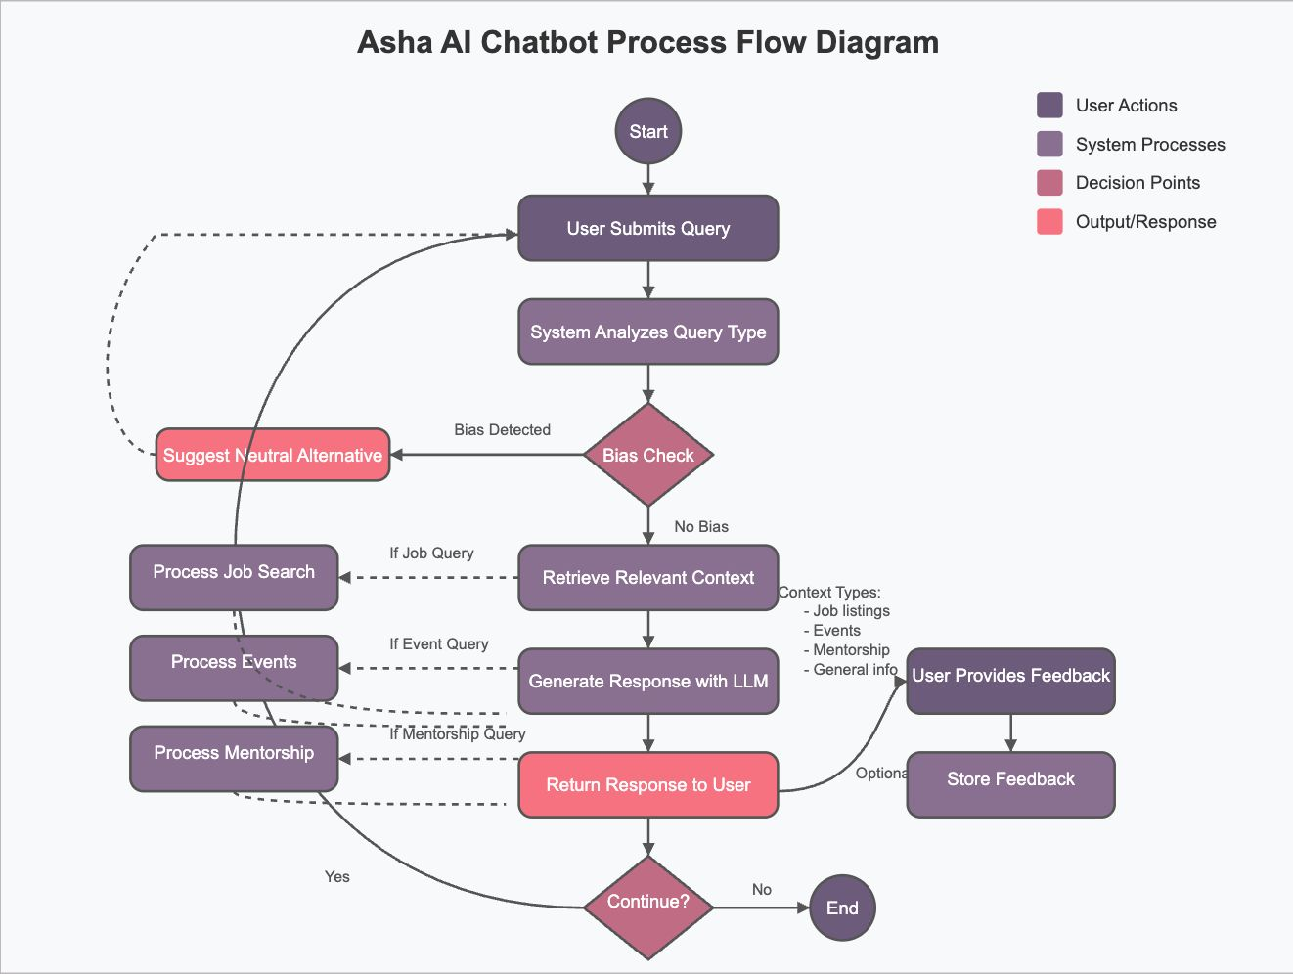
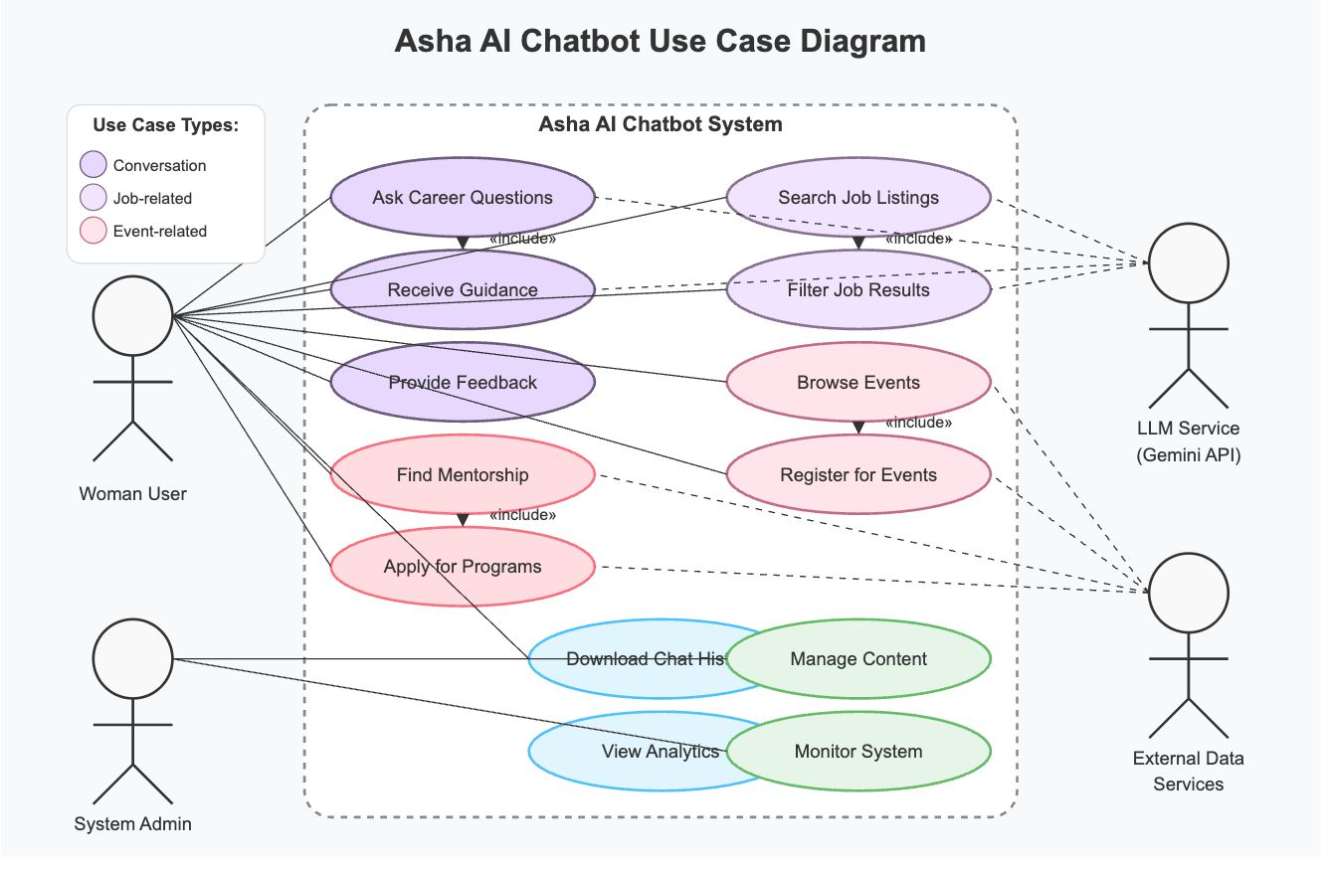
Process flow diagram or Use-case diagram

Slide 8
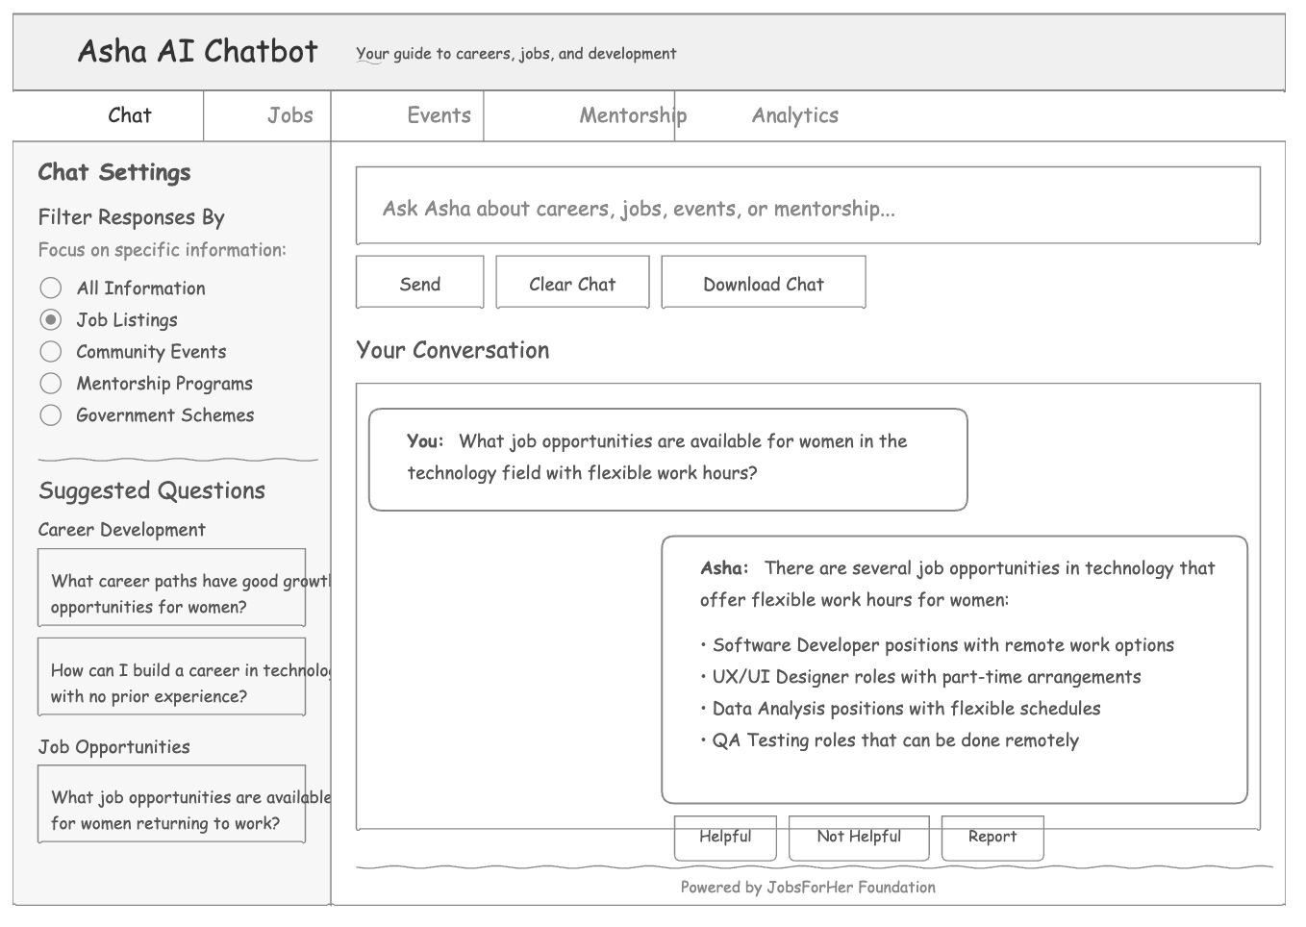
Wireframes/Mock diagrams of the proposed solution
Chat Interface:

Slide 9
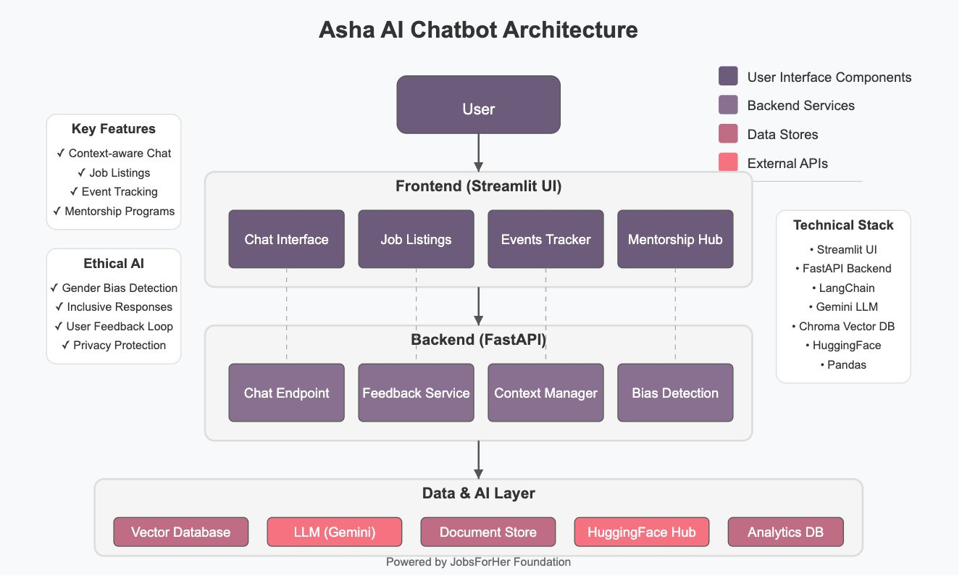
Architecture diagram of the proposed solution

Slide 10
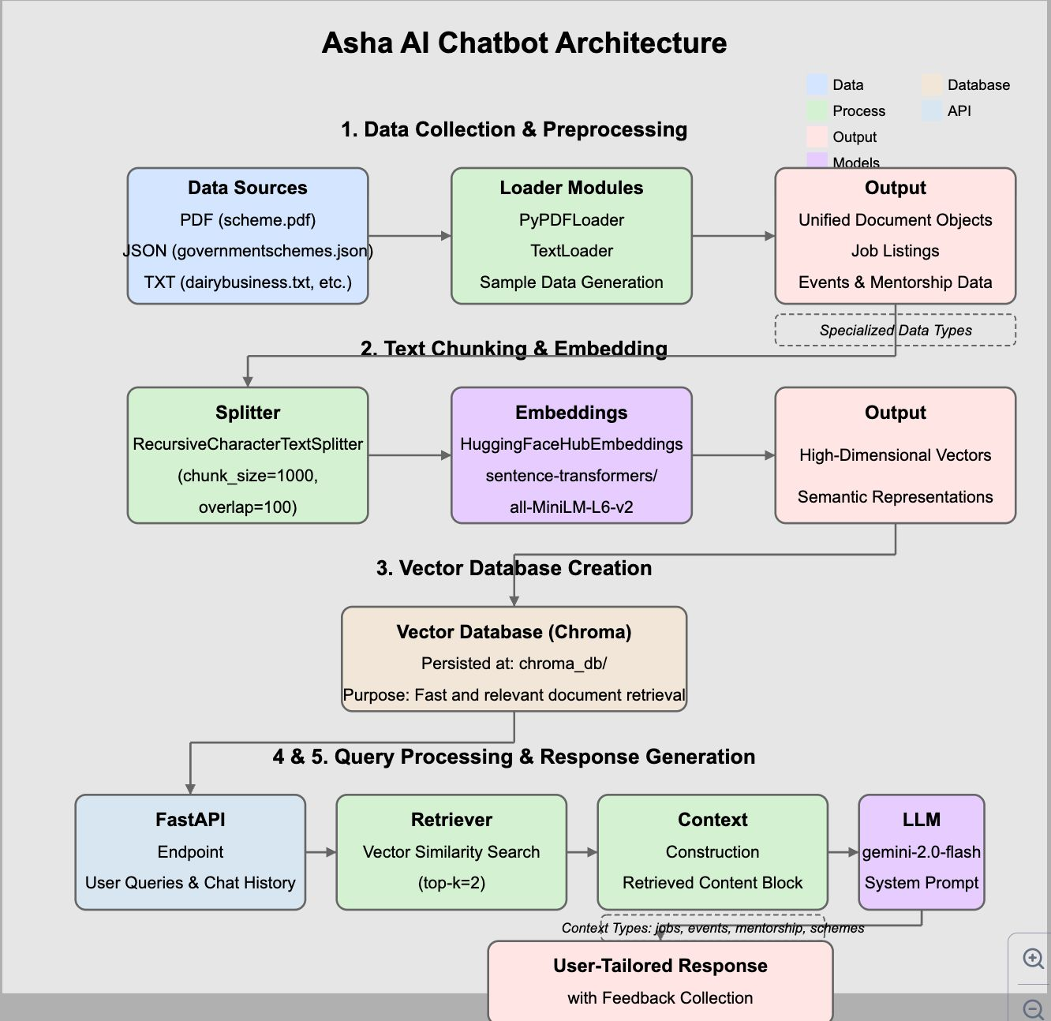
Architecture diagram of the proposed solution

Slide 11
Technologies to be used in the solution
Layer | Technology
Frontend | Streamlit
Backend | FastAPI
AI | Gemini LLM, HuggingFace models
Retrieval | LangChain, Chroma Vector DB
Data Handling | Pandas
Hosting | (Optional) Railway, Render, or small VPS

Slide 12
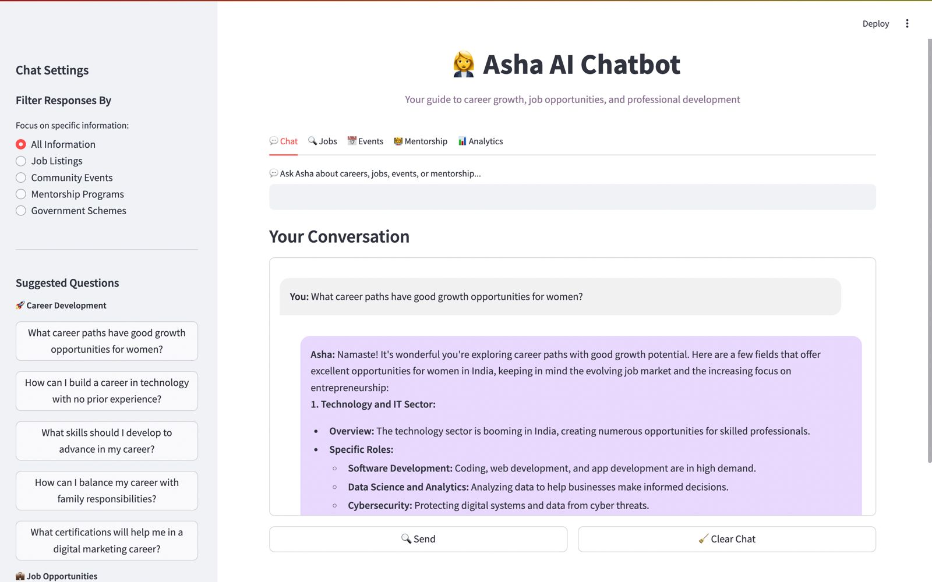
Snapshots of the prototype

Slide 13
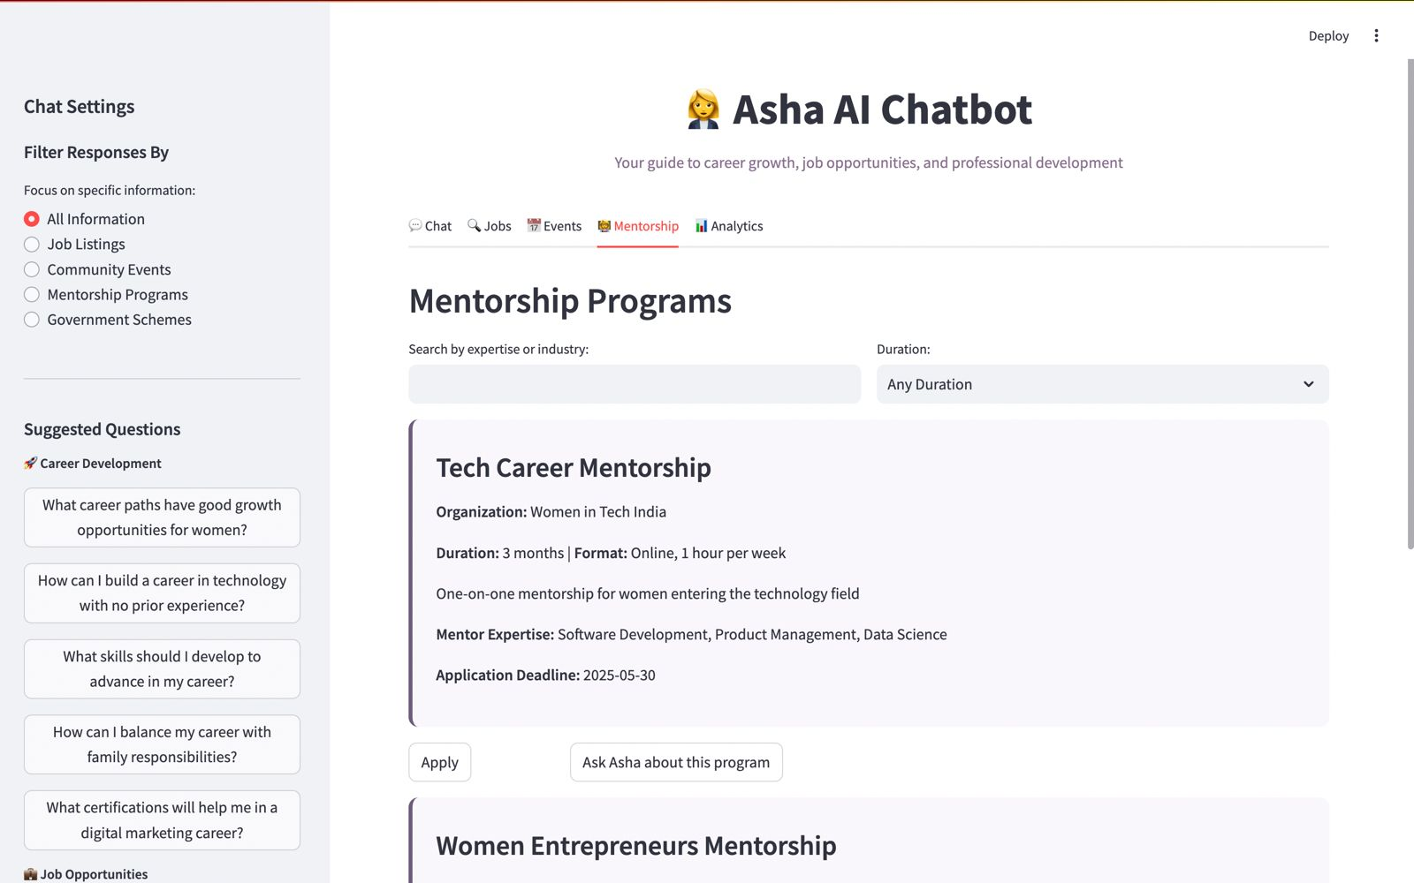
Snapshots of the prototype

Slide 14
Prototype Performance Report/Benchmarking
Start → Analyze Query → Bias Check → (Retrieve Context OR Suggest Alternative) → Generate LLM Response → Return to User → Get Feedback → End or Continue
Response Time and Latency : Response times under 5 seconds per query for an optimal user experience.
Accuracy of Responses : Has a higher accuracy in understanding and providing accurate responses.
Context Awareness : Chatbot maintains context over multiple interactions

Slide 15
Estimated implementation cost (optional)
Component | Cost (₹ per month)
Gemini API (Small scale) | 1000–2000 ₹
Hosting (Railway, Render basic) | 300–800 ₹
Other Tools (Streamlit, HuggingFace free tier) | 0 ₹
Total Estimate | ₹1300 to ₹2800 per month

Slide 16
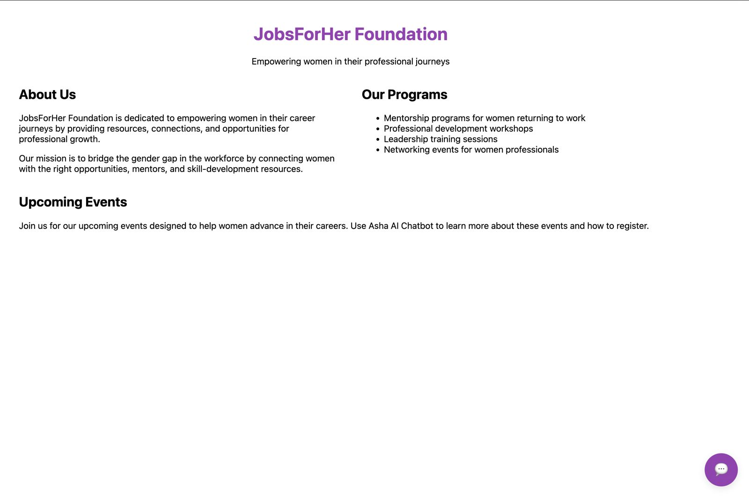
Additional Details/Future Development (if any)
For future development, if you're focusing on a direct implementation of the Asha AI chatbot as a portable chatbot for your website
Click here

Slide 17
Technical Documentation:
Detailed explanation of the chatbot architecture, technologies used, setup instructions, and integration processes. (DECK)
The FastAPI backend manages user queries and feedback, and communicates with an LLM (Language Model) after fetching context from a vector database.
Feedback Handling:
User can submit feedback ("Helpful", "Biased"etc.).
Feedback is stored (for improving bot responses).
Chat Query Handling:
User submits a query.
System analyzes the query type (Job, Event, Mentorship, General info).
It checks for bias.
If bias detected → suggests neutral alternatives.
If no bias → moves ahead.
It retrieves relevant context (from vector database: jobs, events, mentorships).
Generates response via LLM (like Gemini).
Returns response to user.
Optionally collects feedback from the user.
Frontend (Streamlit UI):
Chat Interface (main chat window)
Job Listings tab
Event Tracker tab
Mentorship Hub tab
Backend (FastAPI):
Chat Endpoint (chat processing)
Feedback Service (collects user feedback)
Context Manager (handles conversation memory)
Bias Detection (checks gender-biased language)
Data + AI Layer:
Vector Database (Chroma DB for RAG)
Document Store (jobs.csv, events.json)
HuggingFace Models (for bias detection)
Analytics DB (for feedback storage)
Gemini LLM (for response generation)

Slide 18
Source Code Repository:
Access to the complete source code, preferably hosted on a platform like GitHub, with clear documentation
Please click here:
Gitlink

Slide 19
Demo Video:
A short video (3-5 minutes) demonstrating the chatbot functionalities, user interactions, and key features.
Please Click Here: Video

Slide 20


